Slide 1


Detecting Credit Card Fraud
Credit card fraud is a growing problem that costs businesses and consumers billions of dollars each year. This presentation will explore predictive modeling techniques used to detect and prevent credit card fraud, helping you safeguard your customers and your bottom line.
By Team 3
Yash Parihar, Arbaz Khan, Haoming Zhang, & Pavan Bolla
Haoming
1

Slide 2

s
Brief Overview of the Dataset
Credit Card Transactions
Balanced Classes
Anonymized Features
The dataset is well-balanced, with around 0.39% of the transactions being fraudulent, providing a realistic representation of real-world credit card fraud rates.
The dataset contains over 555,719 credit card transactions, with details like transaction amount, time, location, whether the transaction was fraudulent or not, etc.
The dataset features synthetic data so the PII is not real data, ensuring customer privacy while still providing valuable information for fraud detection modeling.
Haoming
2

Slide 3

Business Problem and Importance of Credit Card Fraud Detection
Credit card fraud poses a significant threat to financial institutions and customers alike. Fraudsters use stolen or forged cards to make unauthorized purchases, leading to substantial financial losses for banks and damaging the trust of cardholders. Effective fraud detection is crucial to protect customers, maintain the integrity of the payment system, and ensure the long-term viability of the credit card industry.
For financial institutions, credit card fraud can result in millions in lost revenue, increased operational costs, and tarnished brand reputation. Customers also suffer the inconvenience of canceled cards, disputed transactions, and the hassle of resolving identity theft issues. Implementing robust fraud detection models is essential to mitigate these risks and safeguard the interests of both businesses and consumers.
Haoming
3

Slide 4

Dataset Overview
This dataset offers a variety of attributes valuable for comprehensive analysis. It contains 555,719 instances and 22 attributes, a mix of categorical and numerical data types.
Trans_date_trans_time & Unix_time
Cc_num
Merchant
Category
Amt
First & Last name
Gender
Street, City, State & Zip
Latitude & Longitude of cardholder's location and merchant.
City_pop
Job
Dob
Trans_num
Is_fraud – This is the target variable for classification purposes.
Pavan
4

Slide 5
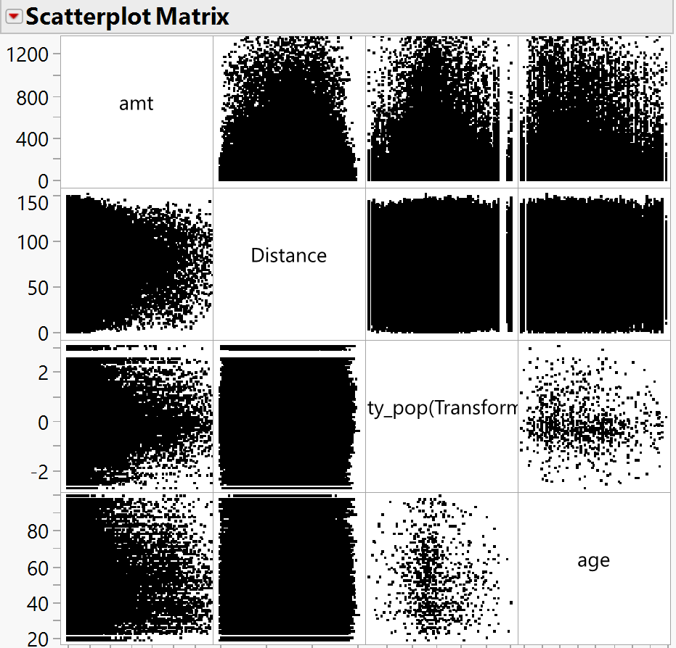
Initial Data Exploration
Important Variables: The most relevant variables for predicting fraud include merchant, category, amt, gender, state, lat, long, city_pop, job, dob, merch_lat, and merch_long.
Observed Trends and Patterns: There is no single strong predictor of fraud, but features like merchant details, transaction amount, cardholder's job, state, and calculated distance between cardholder and merchant (using Great-Circle distance) appear significant.
Pavan
5

Slide 6
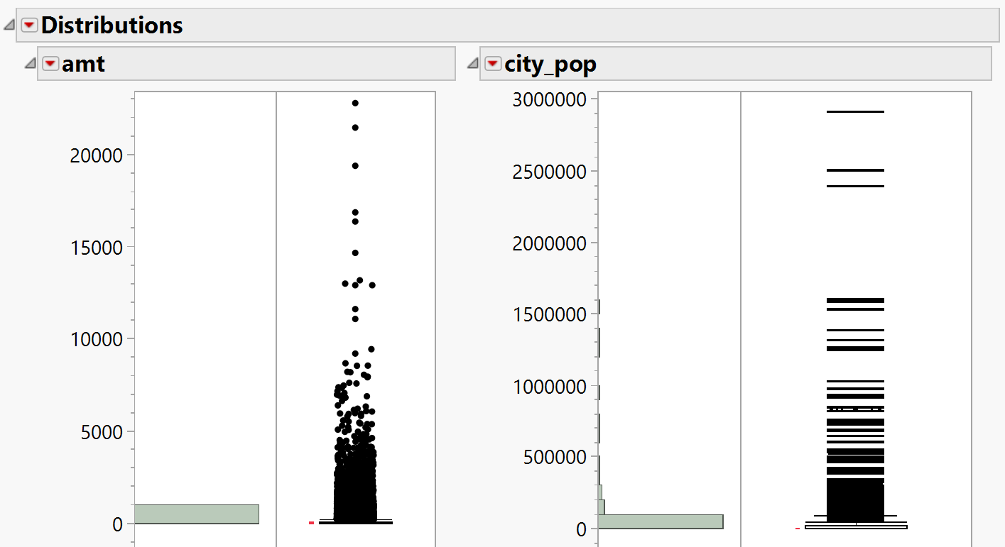
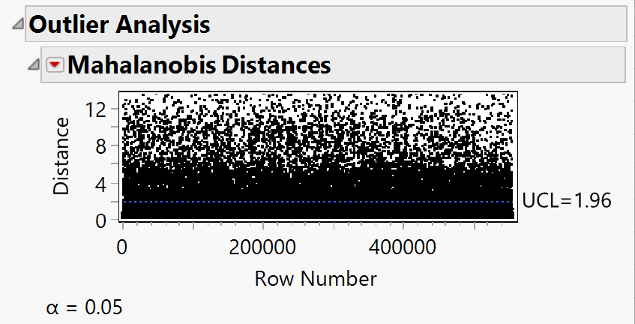
Exploring Missing Values & Outliers
Explore missing values: There are no missing values found in the dataset.
Exploring NA values: Tried to find NA values with all possible NA values such as ‘NA’, ‘N/A’, <blank> and ‘Not Available’. No NA values found.
Exploring Outliers: There were many in amt and city_pop.
For “city_pop” we transformed the column
For “amt” we removed extreme values, so it won’t disturb our models as some models are sensitive to outliers.
Pavan
6

Slide 7
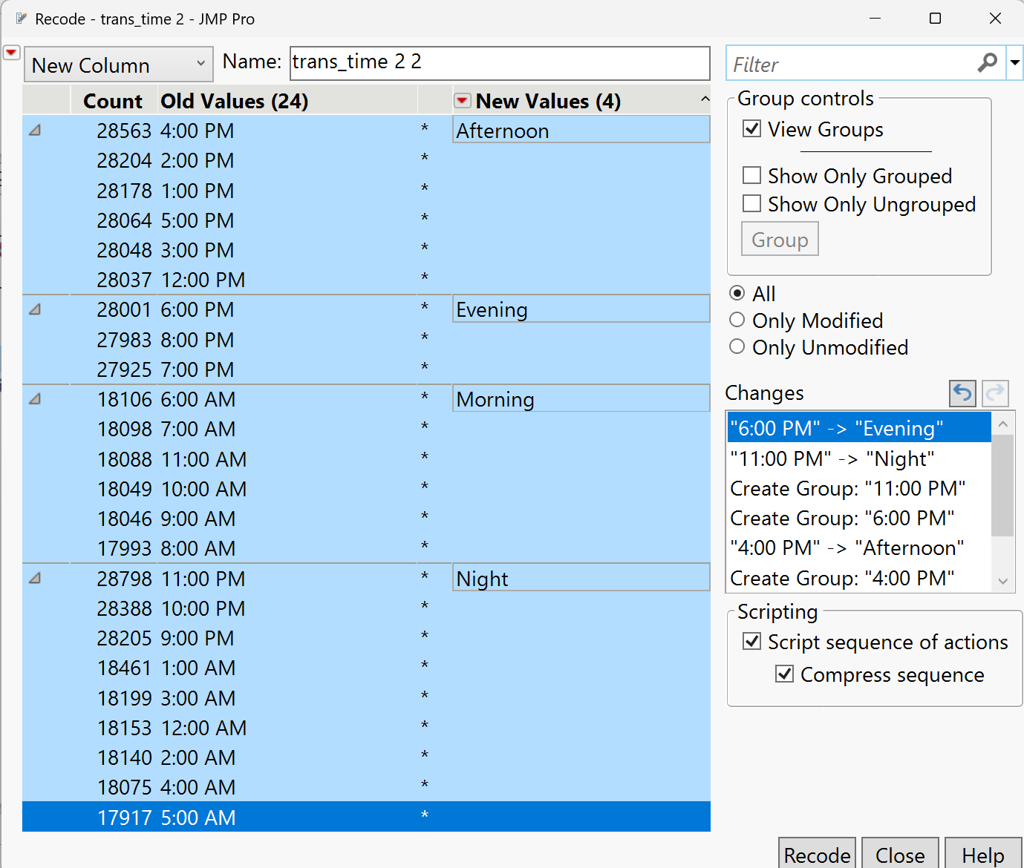
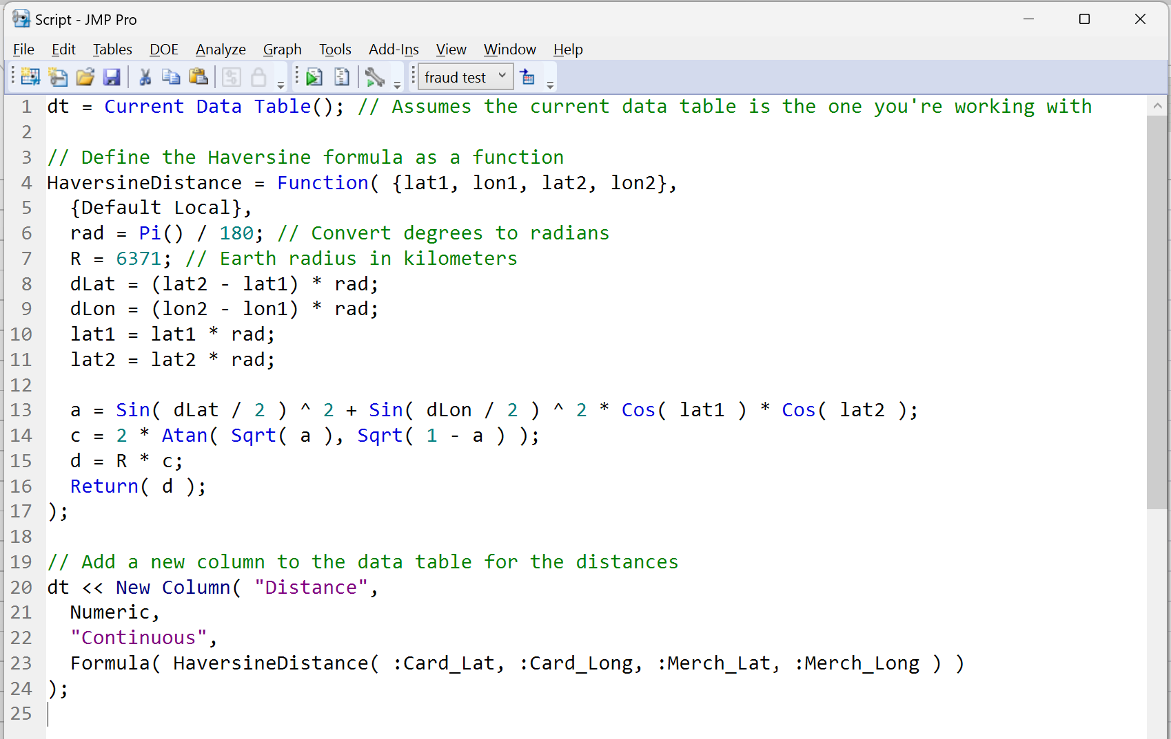
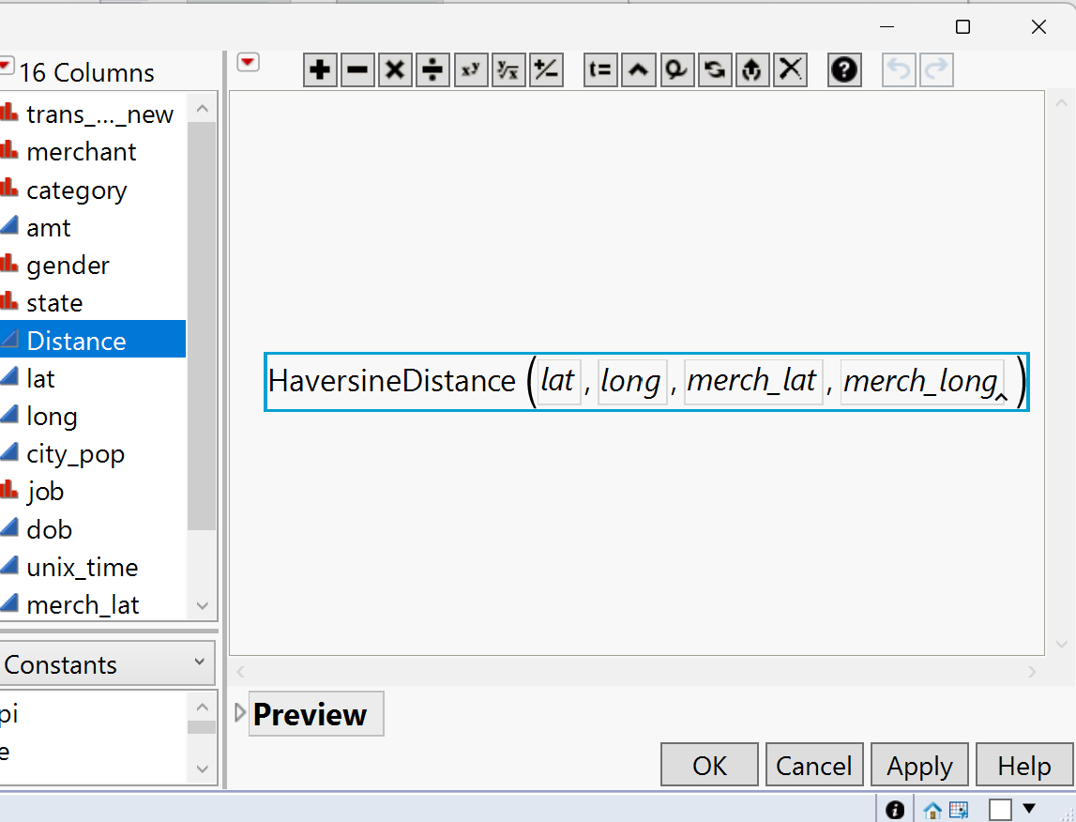
Data Modification
trans_time
Firstly, we divided the time in 24 different categories (as per hours), reducing it from 1,400+ categories.
Then we are recoding and re-grouping them as per daytime like Morning, Afternoon, Evening, and Night.
lat, long, merch_lat, merch_long
Creating a new JSL script that calculates the distance between two points.
Then setting our data table variables accordingly with the formula.
Yash
7

Slide 8
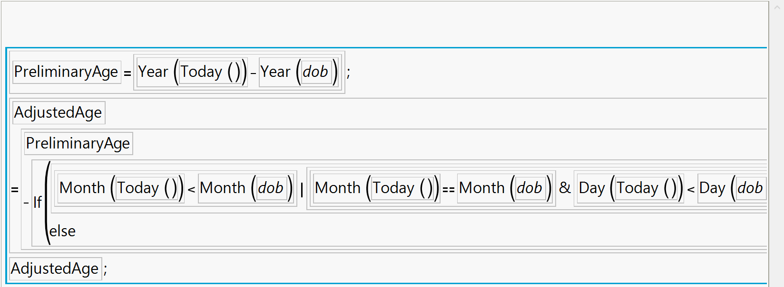
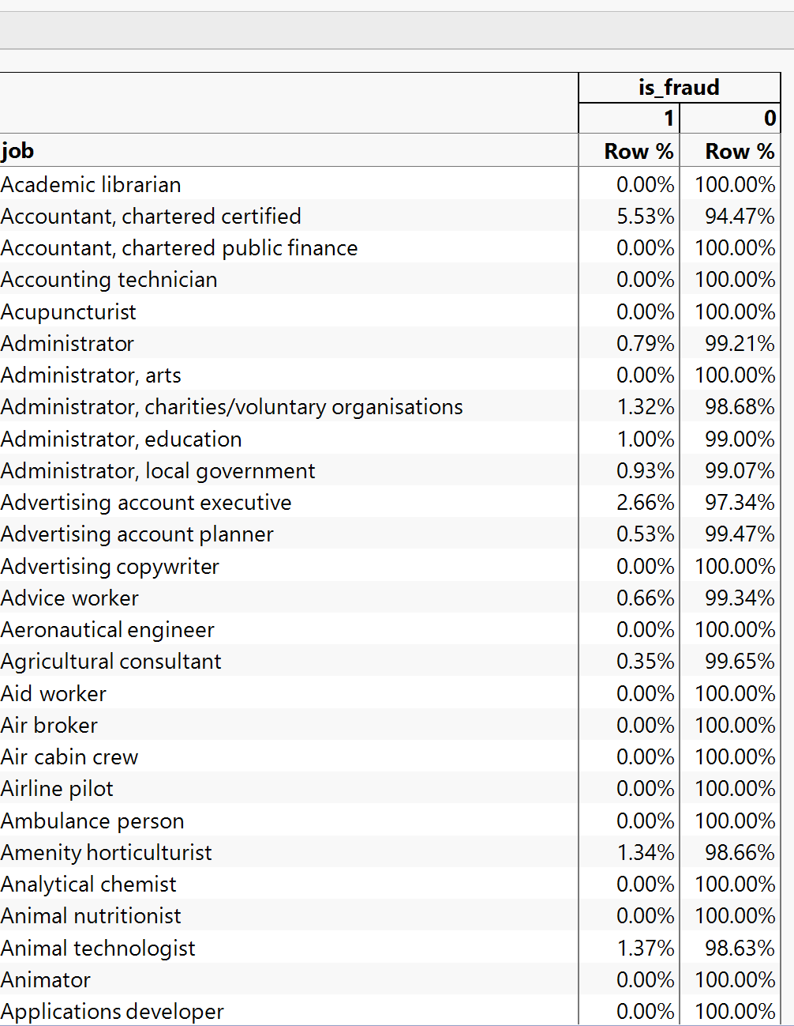
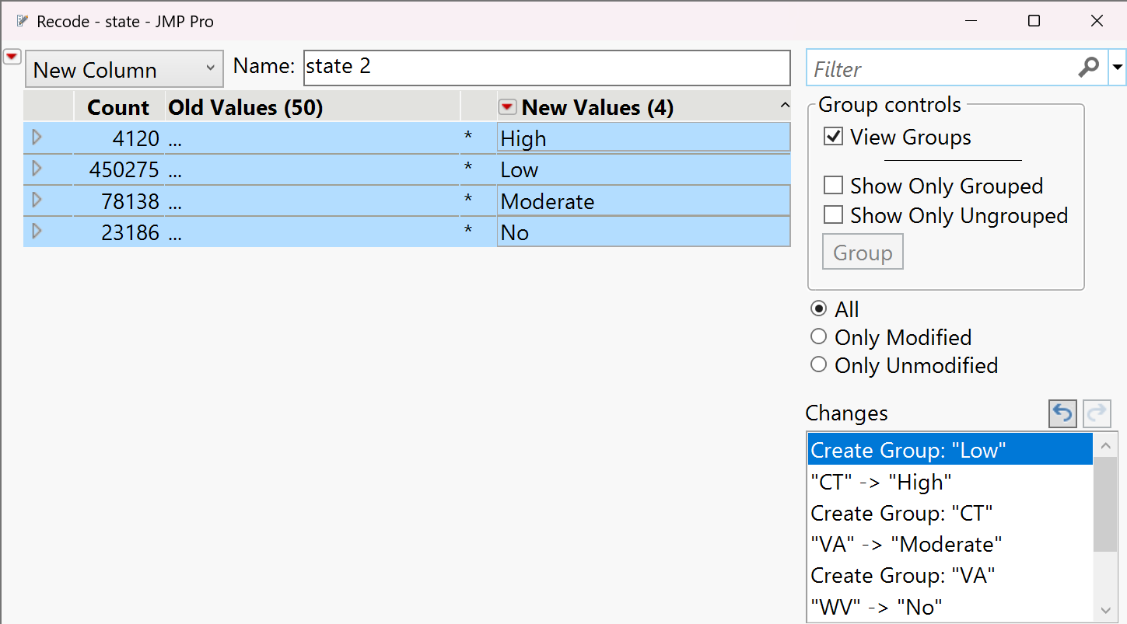
Data Modification Cont.
state
Exploring the % of fraud as per state.
Grouping them into severe, moderate, low, and no fraud states.
As minimum and maximum % of fraud per state is 0% and 1.66% respectively, we will make three equal partitions. i.e.,
0% - No
0.01 – 0.55% - Low
0.55 – 1.10% - Moderate
1.10 – 1.68% - Severe
dob
Making a new column to calculate age for better understanding the data.
job
Checking the fraud % of all the job types.
Grouping them together as per below.
Group 1 – 0%, Group 2 – 0-1%
Group 3 – 1-2%, Group 4 – 2-3%
Group 5 – 3-4%, Group 6 – 5-6%
Group 7 – 6-99% (as only 2 jobs were there)
Group 8 – 100%
Yash
8

Slide 9
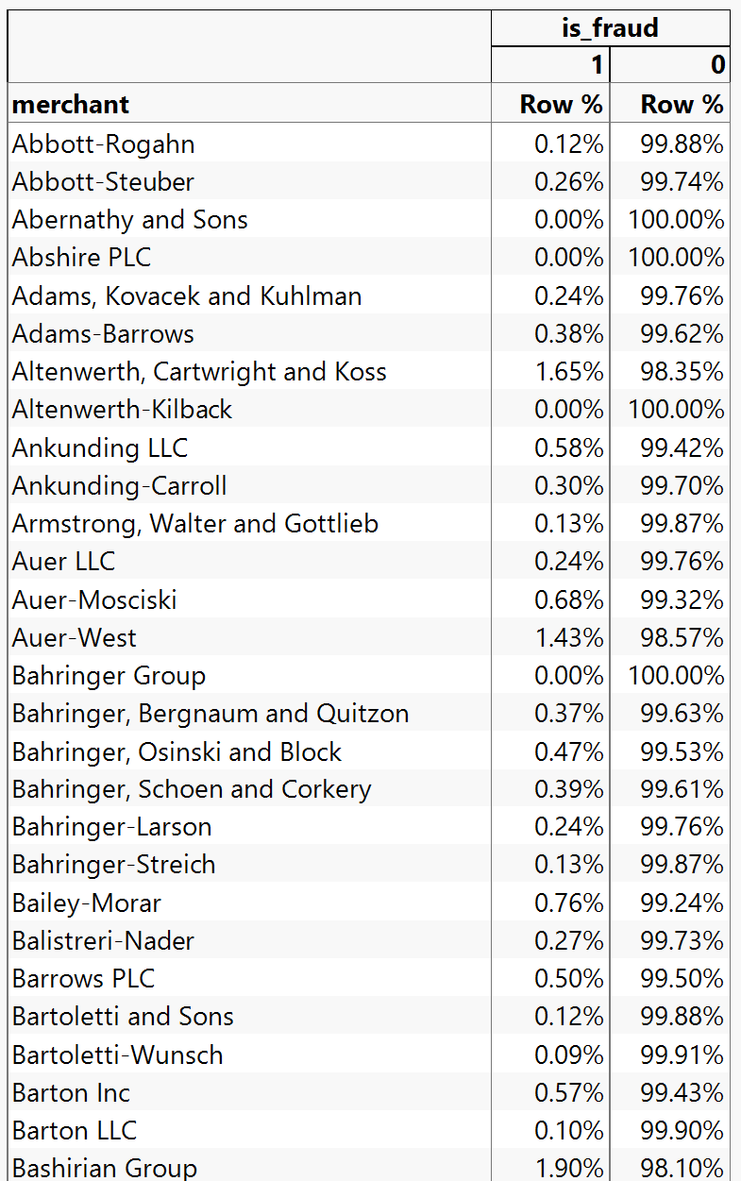
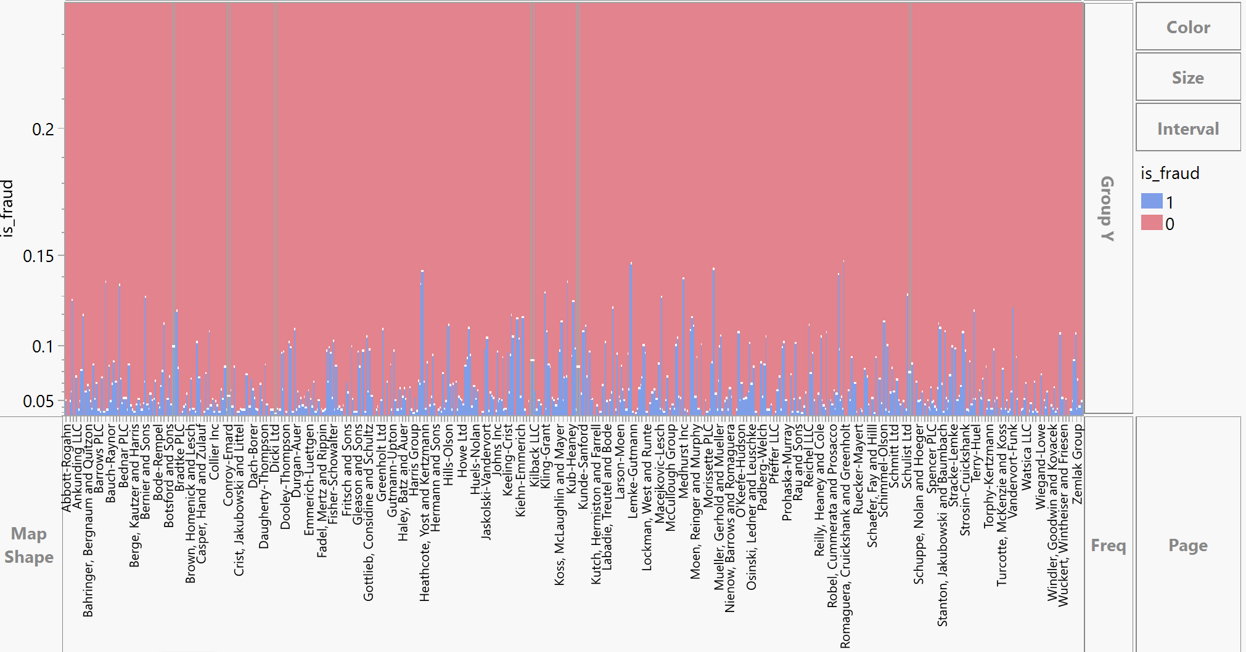
Data Modification Cont.
merchant
After checking the fraud % for each merchant, the minimum and maximum % are 0 and 2.17 respectively.
So, we will be dividing them into 22 different levels of fraud.
0 – 0.1
0.1 – 0.2
0.2 – 0.3
….. So on, till
2.1 – 2.2
Yash
9

Slide 10
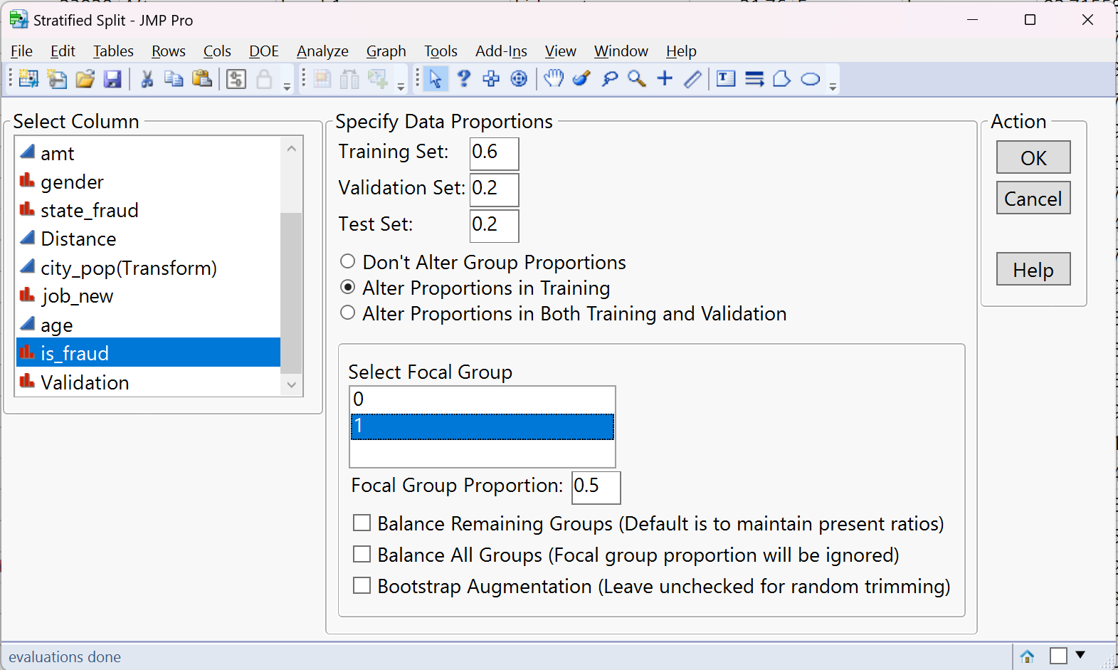
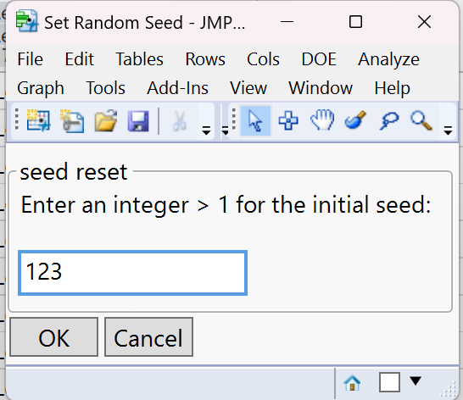
Add-Ins in JMP
Stratified Split Balanced Add-In (Data Partition)
As the dataset is not balanced for over target variables, i.e. is_fraud (1) is < 1% (0.39% in total), we will be doing oversampling using Stratified Split Balanced Add-In
Set Random Seed
Setting random seed to ensure that results are reproducible.
Yash
10

Slide 11

Model Overview
1
Logistic Regression: Some of the variables were not contributing (P-Value)
2
Decision Tree: We got 47. On Prune we see the best split at 41.
3
Boosted Tree
4
Bootstrap Forest
5
Neural Network
6
Discriminant
7
KNN: Best K = 3
8
Naive Bayes
9
Model Averaged
Yash
11

Slide 12
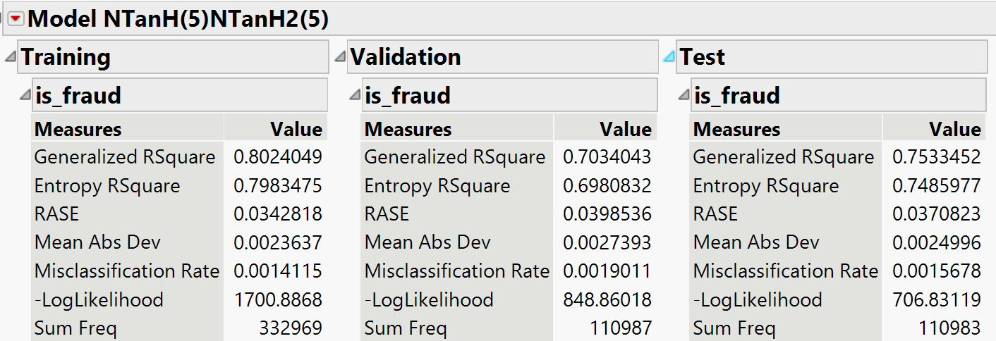
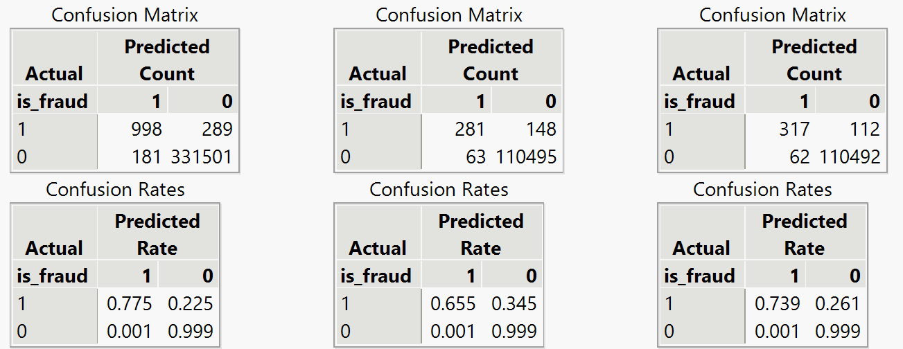
Best Model Results : Neural Network
Here we have tried different setting and different variable selection to get the best result.
Model NTanH(5)NTanH2(5) is the best setting, considering “trans_time_new”, “merch_fraud_level”, “category”, “amt”, “gender”, “state_fraud”, “distance”, “city_pop(transformed)”, “job_new”, and “age”.
Total Accuracy is 0.9980 i.e., 99.8%
Accuracy of 1 is 0.6550 i.e., 65.5%
Misclassification Rate is 0.0019 i.e., 0.19%
For variable selection we considered P-Value from Logistic Regression and Column contribution from Decision Tree.
Trade-off & Complexity
The model has a good balance of both accuracy and complexity.
Yash
12

Slide 13
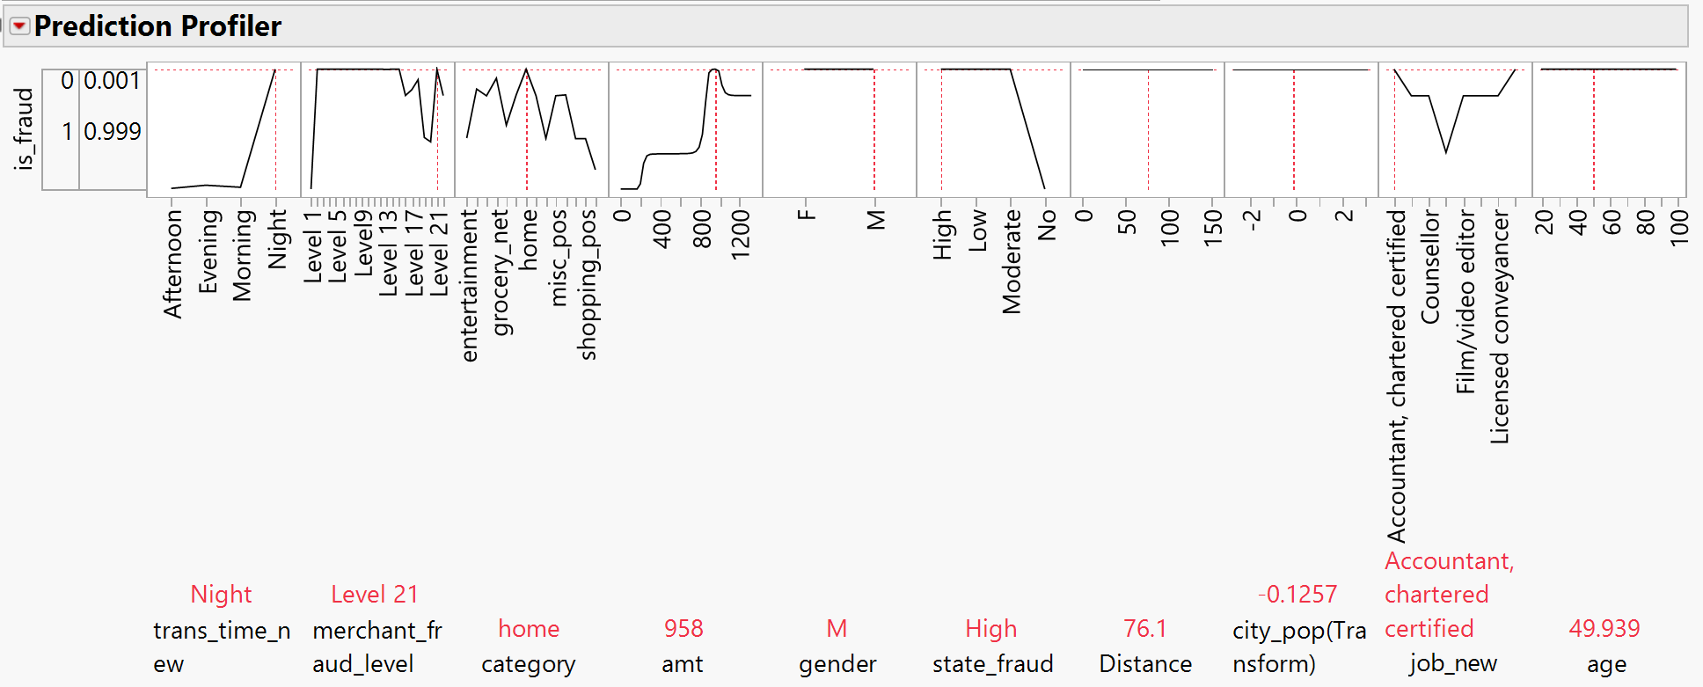
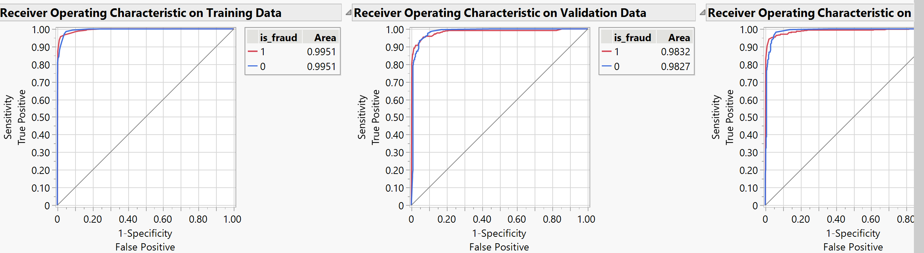
Best Model Results : Neural Network Cont.
Yash
13

Slide 14
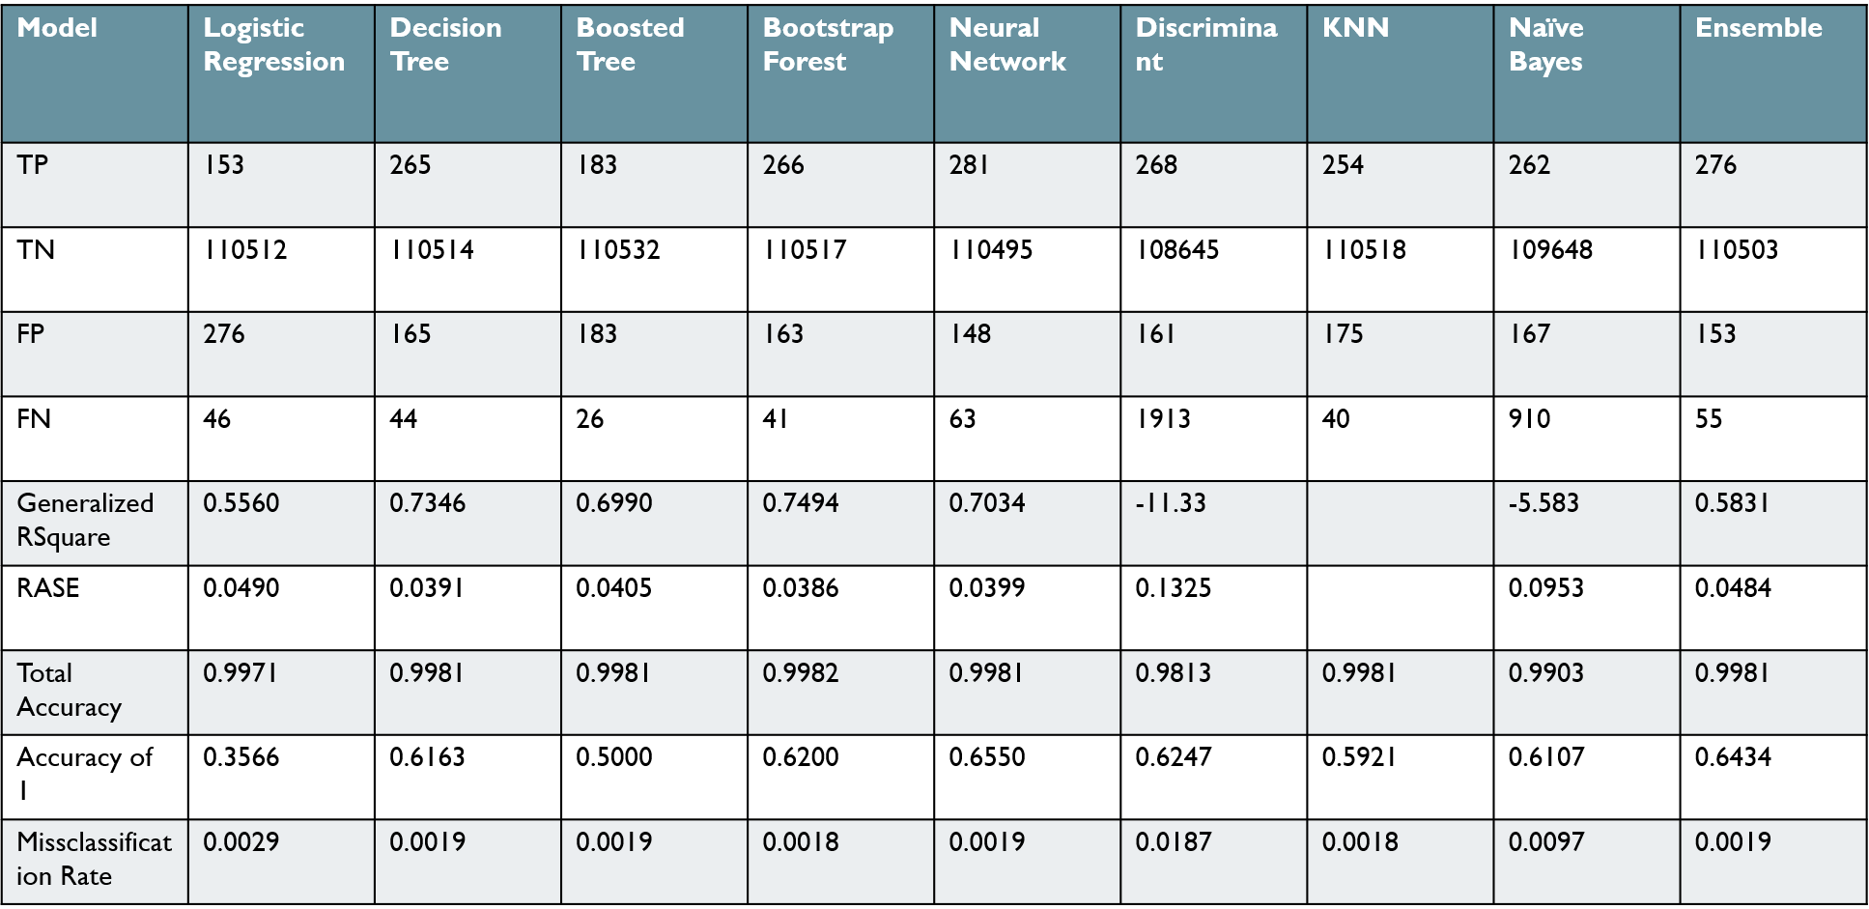
Model Comparison
Arbaz
14

Slide 15
Business Findings & Recommendation
Implementing enhanced monitoring of transactions that occur during times with higher probabilities of fraud, such as late-night hours,
It's a common observation that fraudulent transactions often fall under the "home" category and involve merchants with a high fraud level.
Setting thresholds for transaction amounts that are likely indicative of fraud and apply additional authentication steps for transactions exceeding this limit.
Paying more attention to transactions by individuals in certain occupations that show higher fraud rates to ensure these patterns are valid and not biased.
Arbaz
15

Slide 16
Conclusion
Our exploration into credit card fraud detection has yielded a neural network model with exemplary accuracy. This model's adeptness at identifying fraudulent transactions marks a significant step forward in enhancing transactional security. The results affirm the vital role of predictive analytics in establishing more secure financial environments.
Arbaz
16

Slide 17
References
Books
Shmueli, G. (2023). Machine Learning for Business Analytics: Concepts, Techniques and Applications with JMP Pro 2nd Edition. Hoboken, NJ: Wiley.
Software
JMP Pro 16.2.0
www.Kaggle.com
Dataset Source: https://www.kaggle.com/datasets/kelvinkelue/credit-card-fraud-prediction?select=fraud+test.csv
www.geeksforgeeks.org
Great Circle Distance: https://www.geeksforgeeks.org/great-circle-distance-formula/
Appendix
Full report with all the SEMMA steps and Snippet are uploaded on Google Drive. Follow link below
https://docs.google.com/document/d/1YGRVTDxX1C9jxBXL0QmApPma3gfj74Q1/edit?usp=drive_link&ouid=114967200591466545623&rtpof=true&sd=true
Arbaz
17

